Slide 1
Unlocking Airbnb
Patrick Kim

Slide 2
Can we help Airbnb hosts better understand the hospitality market?
Make informed decisions to increase revenue

Slide 3
What are we trying to do here?
Price Prediction
Analyze what factors influence the price of a rental.
Comment Analysis
Survey customer reviews regarding their experience.

Slide 4
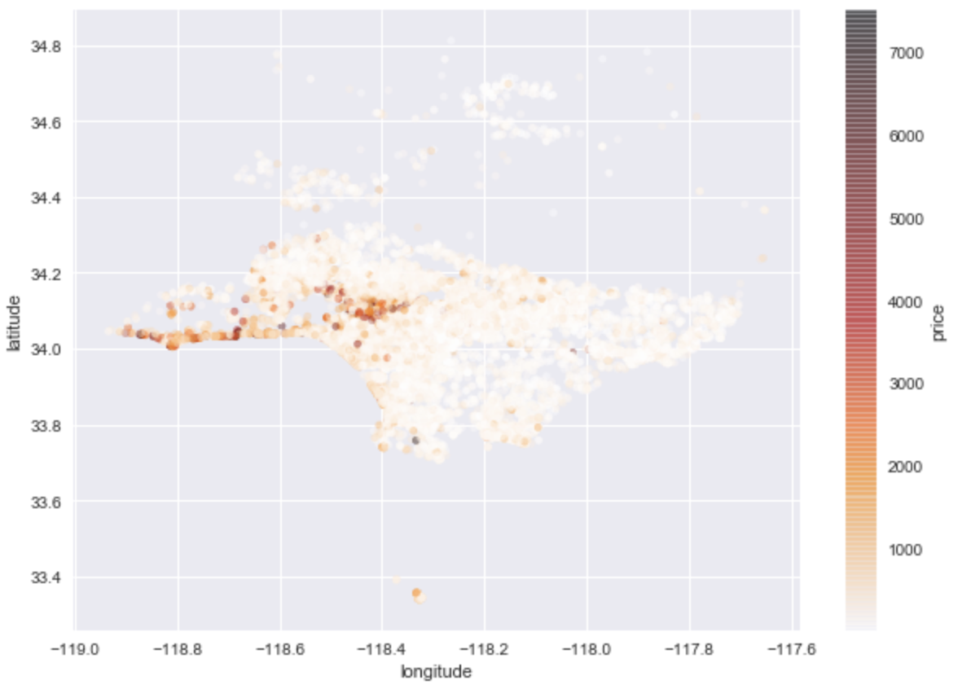
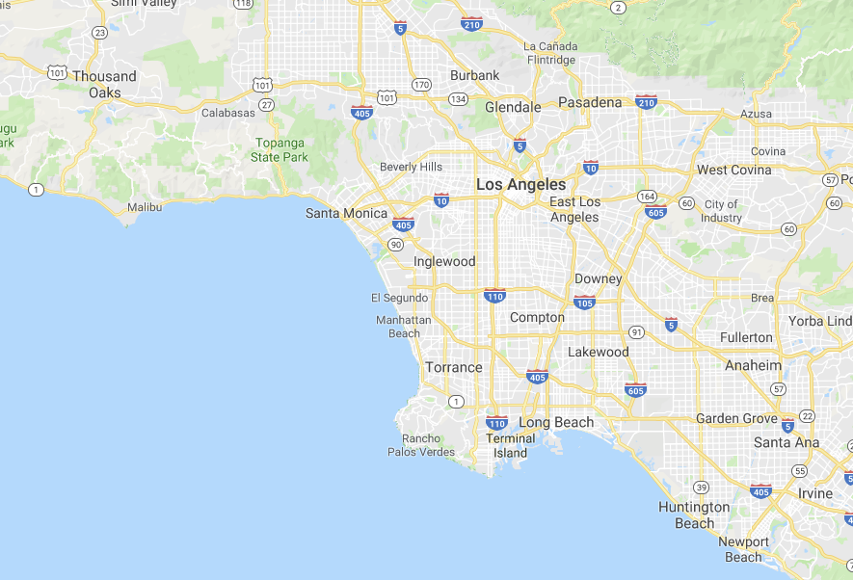
Understanding Your Market

Slide 5
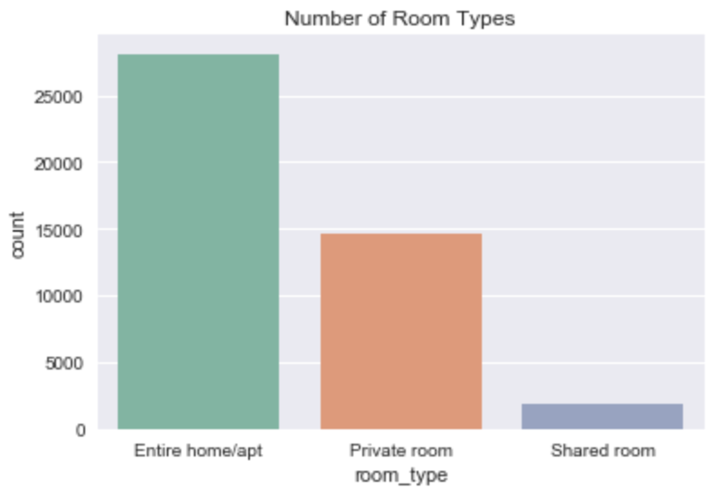
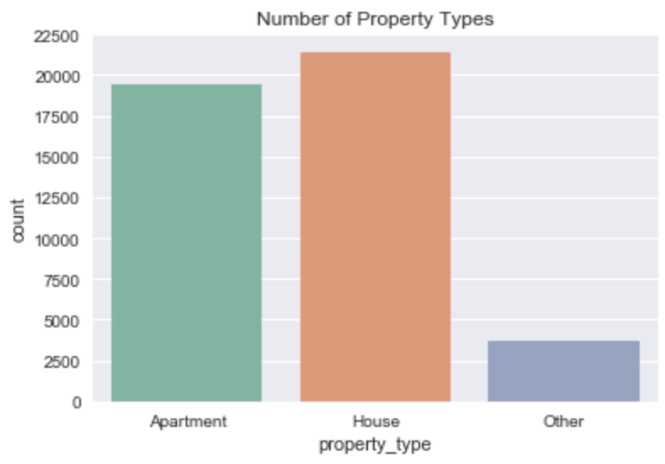
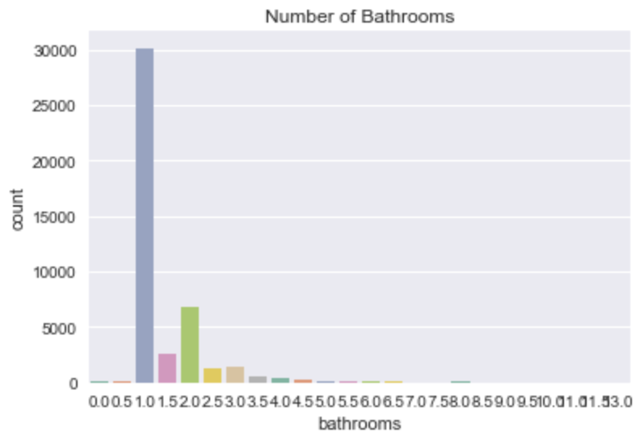
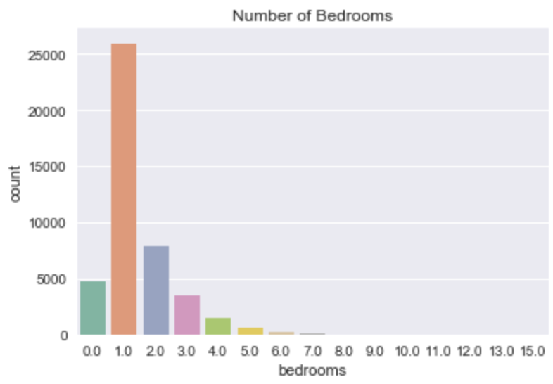
Understanding Your Market

Slide 6
$129
71%
Average error between train/test data (RSME)
Of variance explained (R2)
Not ideal, but there are many factors that could improve this.
Pictures, Reviews, Availability

Slide 7
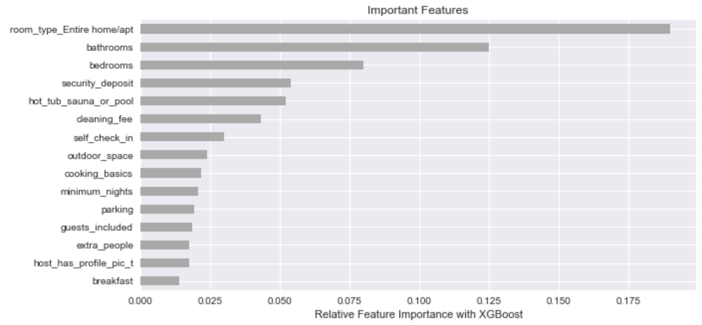
Influential Factors

Slide 8
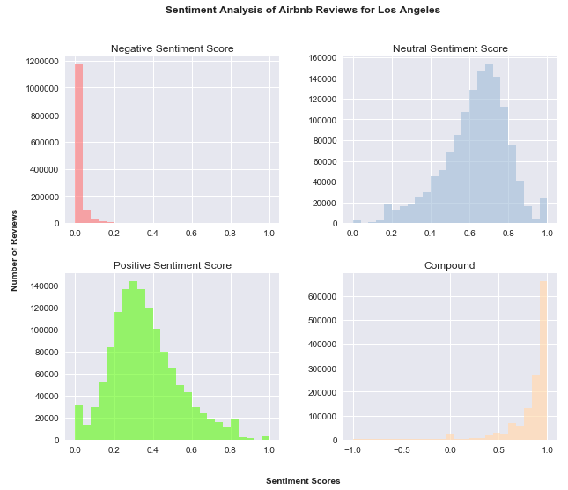
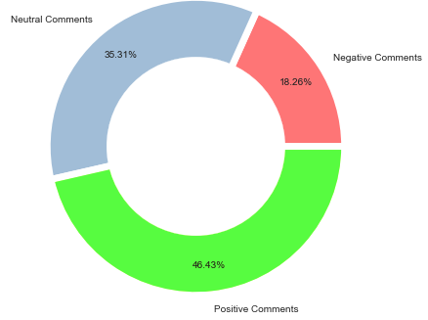
Sentiment Analysis

Slide 9
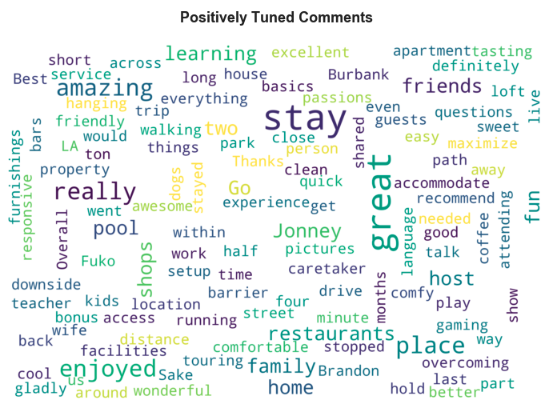
Sentiment Analysis
The apartment is clean and visually appealing.
The host is nice and made the experience comfortable and easy.
The area is centrally located with short walking distances, and has beaches and restaurants nearby.

Slide 10
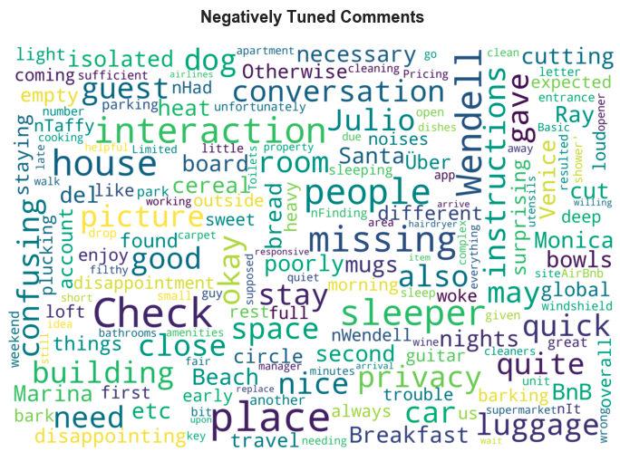
Sentiment Analysis
The apartment and/or bathroom (especially the shower) are dirty.
Problems in communicating with the host.
The area is too noisy and is disruptive during the night.

Slide 11
THANKS!
Any questions?

